Slide 1
Professional Practice of Education Assistants
Practicing Confidentiality

Slide 2


What is confidentiality?
The ethical principle or duty that a person will hold secret all information relating to another unless that person gives consent permitting disclosure, thereby showing respect.
nondisclosure of certain information except to another authorized person
privacy, secrecy, discretion

Slide 3

Activity #1
Fill out Confidentiality Worksheet.
Compare your answers with one other person.
Discuss worksheet as a class.

Slide 4

Activity #2: Case Scenarios
In small groups discuss case scenario and discussion questions.
Read scenario to class and present rationale.
Discuss further.

Slide 5
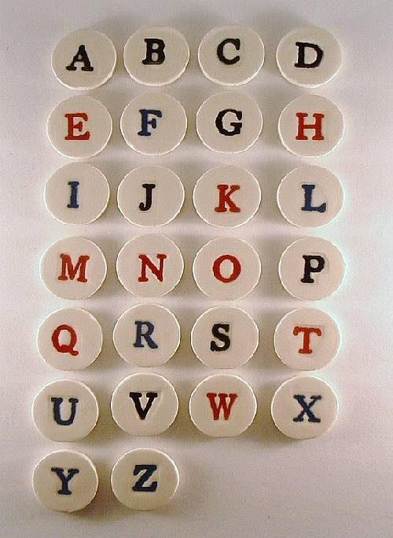
Activity #3
Work in pairs.
Pick an alphabet tile.
Create 3-5 statements that start with the selected letter to describe an action or related principle to the area of CONFIDENTIALITY.
Select your top one.
Print on paper strip.
Tape to classroom chart.

Slide 6

Best practice!

